Slide 1

Large Displacement Optical Flow Estimation Based on Warping
SAIWEN W., YIFAN S., YIJUN P., XINYUAN Y.
Notes:
DeepFlow: Large displacement optical flow with deep matching
Published ICCV‘13 (International Conference on Computer Vision)
Module implementation (in C language): can be easily adapted to other algorithms.
DeepFlow: Original implementation published with the paper. (Easy baseline.)
FastDeepFlow: Up-to-date optimized code. (Hard baseline.)

Slide 2
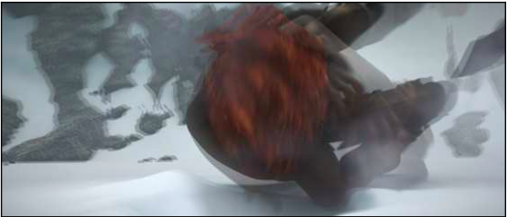
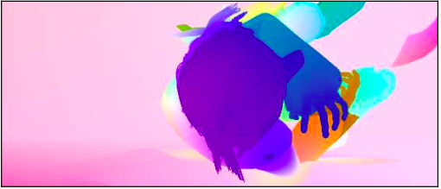
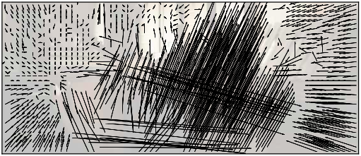
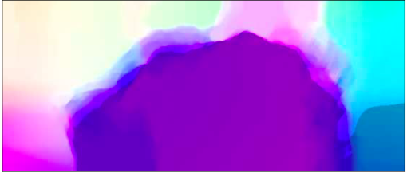
Problem
Find the relative displacement of each pixel in a given pair of images.

Slide 3
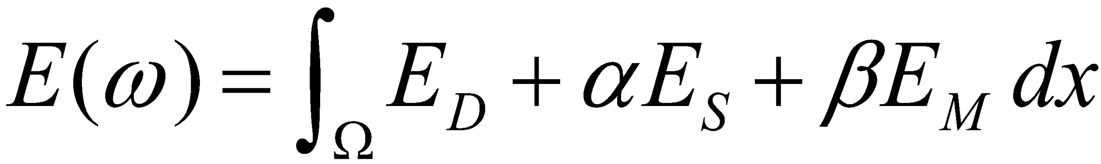
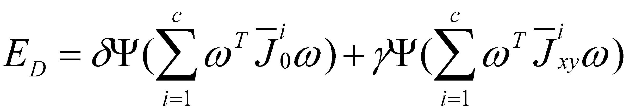
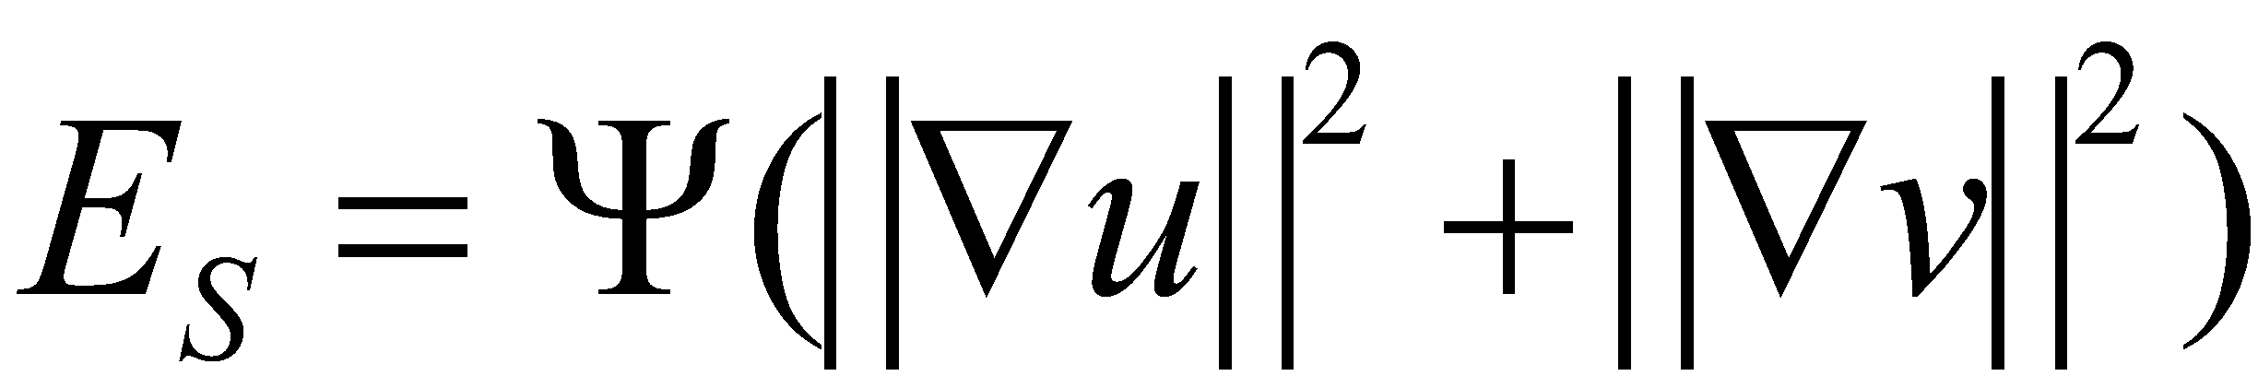
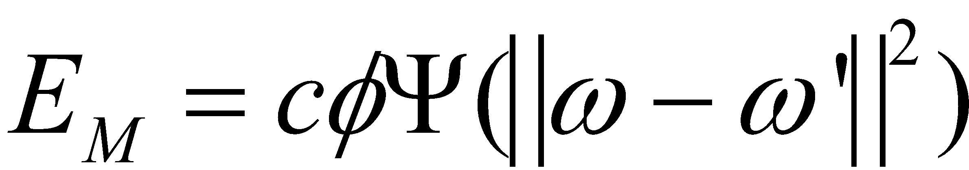
Algorithm
Data Term
Smooth term
Matching term
Notes:
The baseline for optical flow estimation is to minimise an energy function based on a data term and a smoothness term. The first one typically assumes that the color and the gradient are constant along the flow while the second assumes that the flow is smooth. A matching term to penalise the difference between input matches and flow estimation is added to the classic data and smoothness terms. The energy is then minimized throw a coarse-to-fine scheme. The flow is estimated at a coarse version of the images and is iteratively refined.
It is then optimised using fixed point iterations and classic linear system solver such as SOR(Successive Over Relaxation).

Slide 4
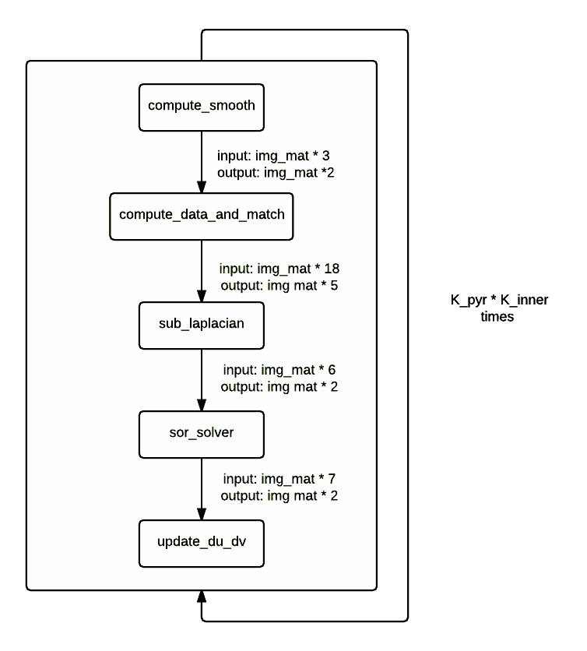
Algorithm Flow
sor_solver:
K iterations of successive over-relaxation method
Computational complexity:
O(K_pyr * m * n * K_inner * K_solver)
Memory complexity:
O(K_pyr * m * n * K_inner * K_solver)
compute_data and_match:
Prepare pixel-wise linear system: Ax’ = b
Computational complexity:
O(K_pyr * m * n * K_inner)
Memory complexity:
O(K_pyr * m * n * K_inner)
Notes:
Algorithm characteristic: lots of interactions, use as much memory with the increase of size of image for computation use.

Slide 5
Cost Measure
Using Perf to measure cycles and memory transfer
Using Geekbench to measure peak performance of RAM
which is used in roofline model
Measure flops as (addition, multiply, division, square root)
Divisions and sqrts costs 28 cycles, regard them as one flop may underestimate flop count. Which leads to lower performance.
Notes:
the amount of division flops should not be neglected

Slide 6
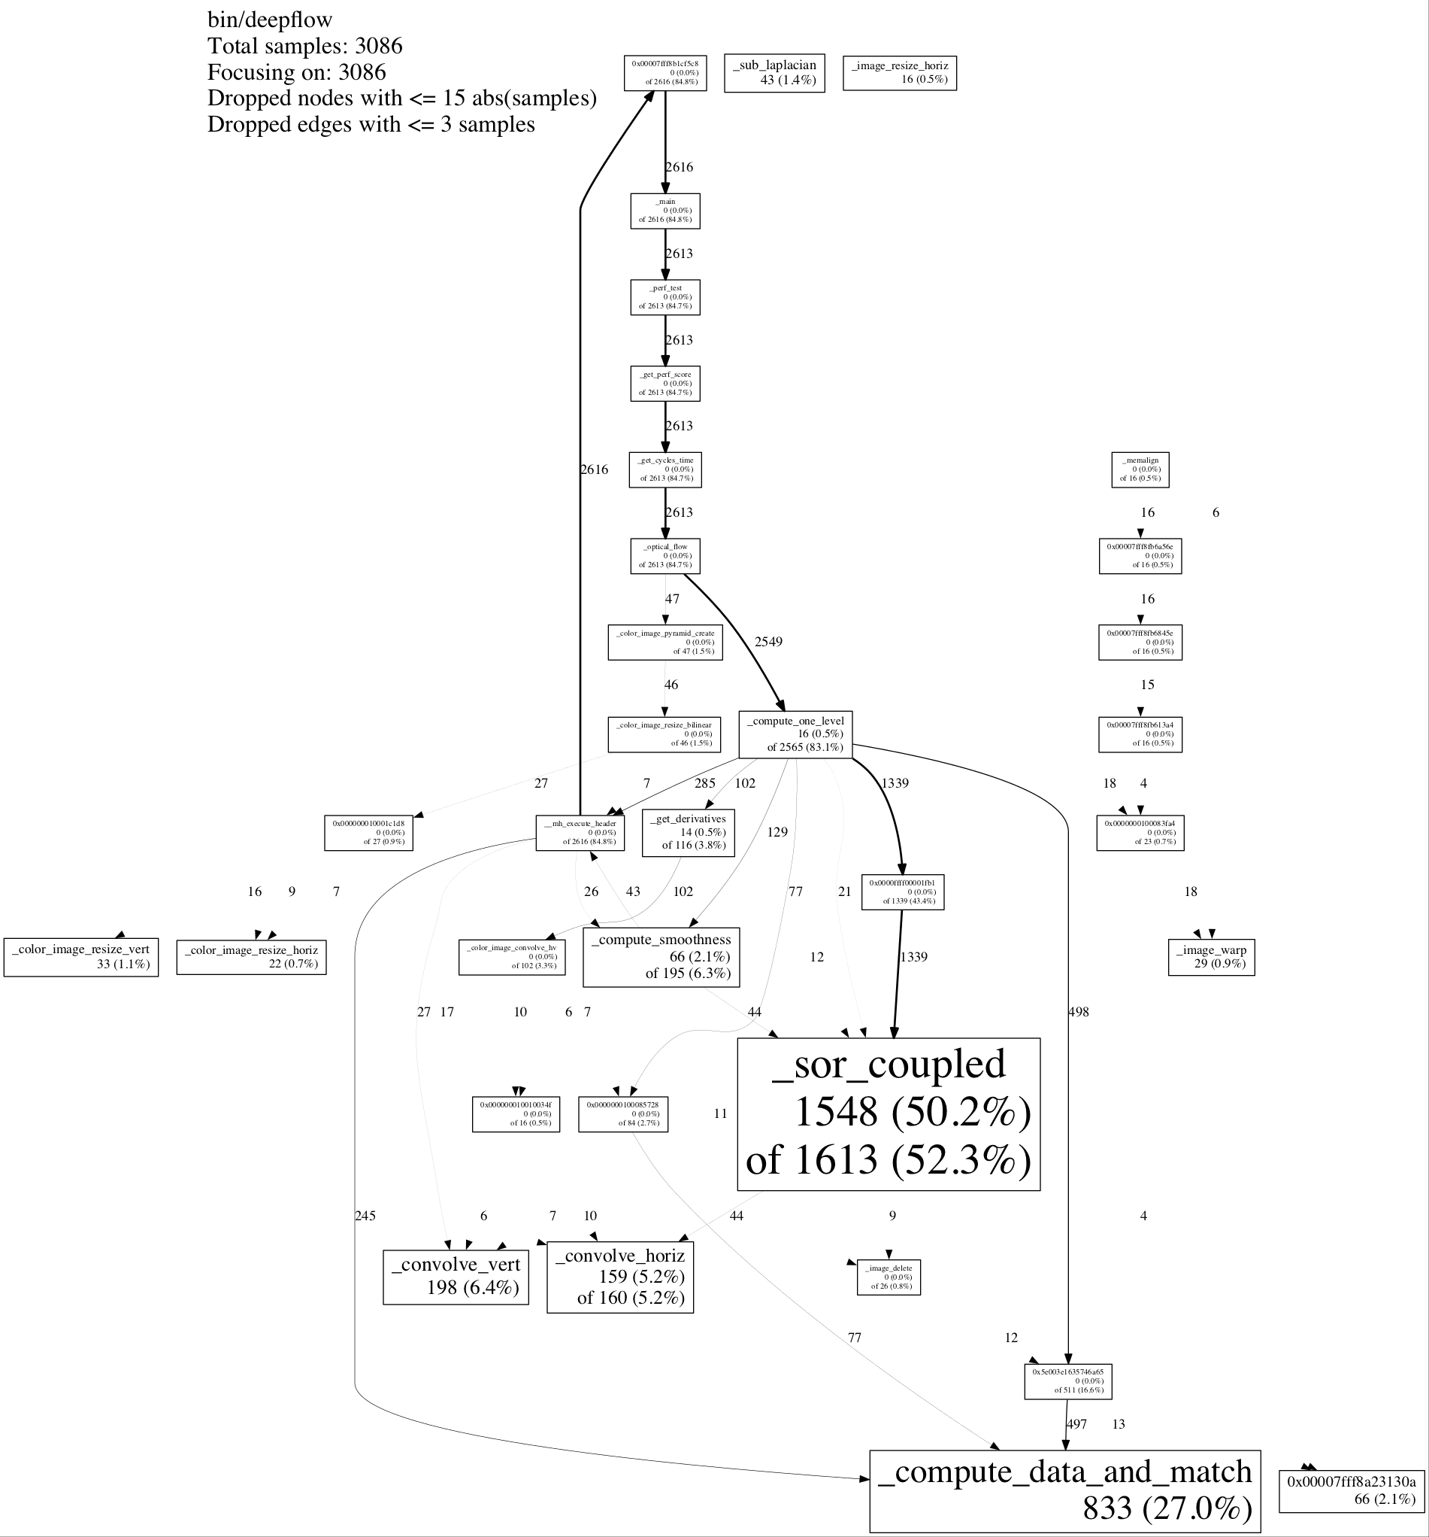
Bottlenecks
Using google profiler to plot calling
graph
Two functions:
Solver
Computer data and match

Slide 7
Optimization Methods
compute_data_and_match:
1. compiler flags
2. function inlining
3. scalar replacement
4. code motion
5. memory reuse
6. AVX
sor_solver:
compiler flags
code motion
scalar replacement
blocking (1x4, 2x2)
partial vectorization (SSE)
Notes:
Match:
flags: -o3 -o0 -core-avx-i -fno-tree-vectorize
scalar replacement: reduce duplicate memory access
code motion: precompute share division components (very expensive)
memory reuse: reuse data structure shared between different iteration levels
AVX: unrolling, blocking for memory access. parallel computation.
Solver: -o3 -o0 -core-avx-i -fno-tree-vectorize
Code motion: precompute j * stride + i. Use this as index origin. Although the flops count is not reduced, the performance is improved
Scalar replacement: the data loaded from memory which is reused
Blocking: we did unrolling when blocking. Explain 2x2 matrix
SSE:

Slide 8
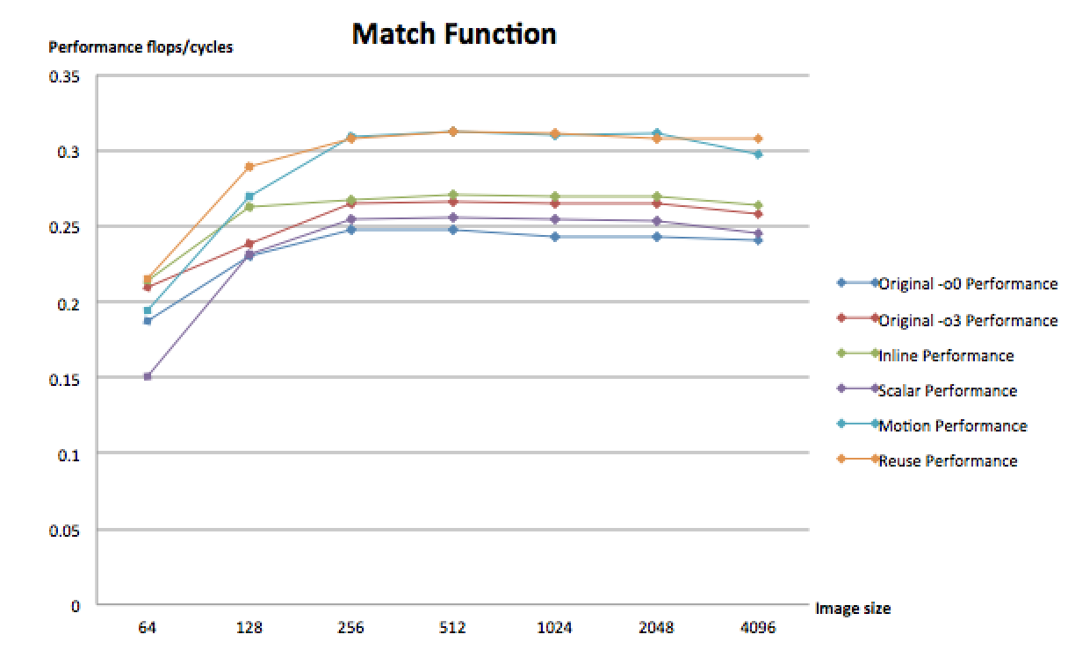
Performance Plots (match function 1)

Slide 9
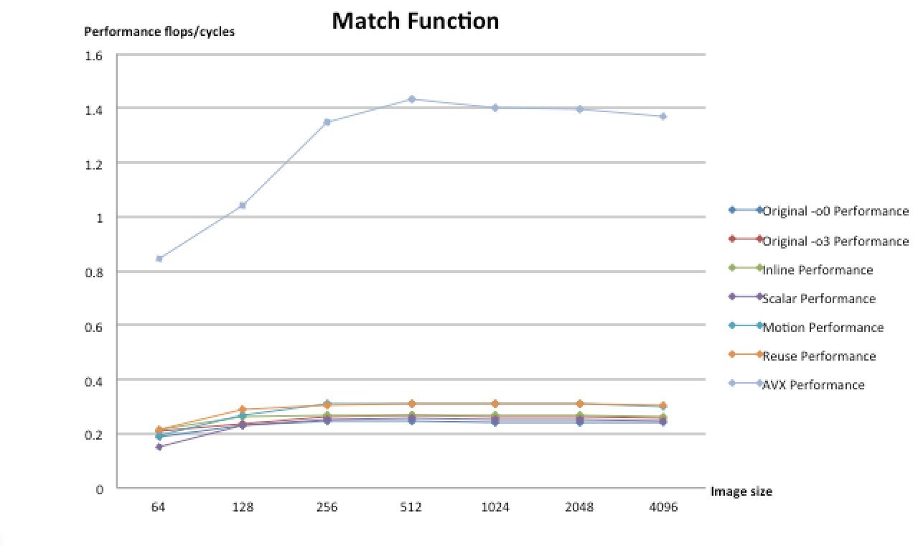
Performance Plots (match function 2)
6x
Notes:
AVX benefit from blocking and parallel computing
Reuse memory: flush the cache of the image head. so this method does not work.
cache has already been flushed when you simultaneously load 18 matrices each round.

Slide 10
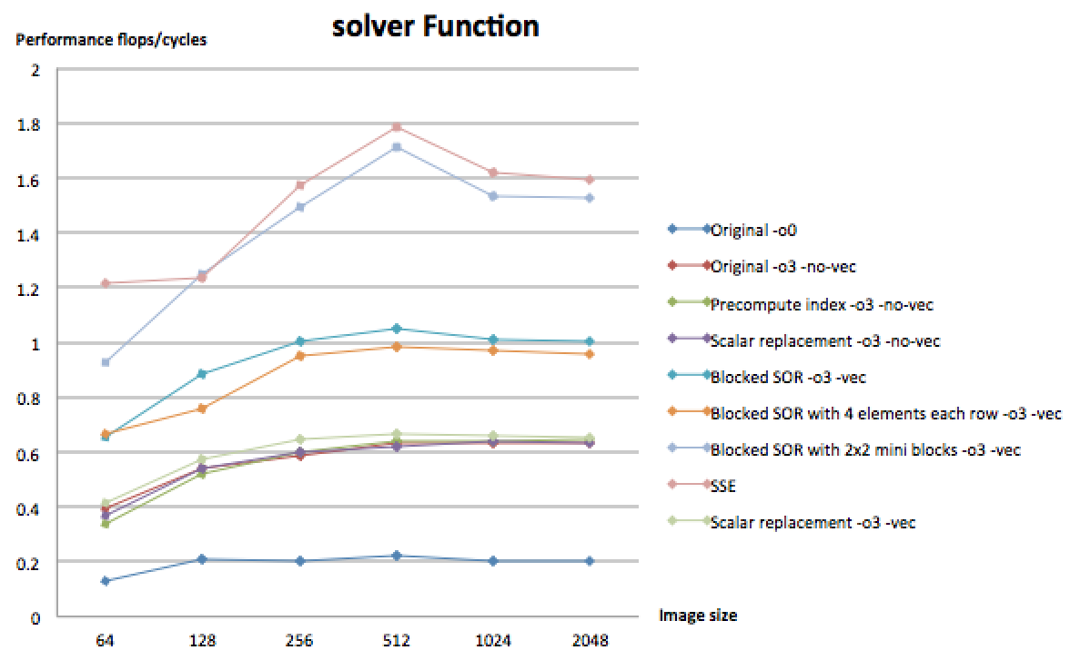
Performance Plots (solver function)
9x
Notes:
-o3:
Blocking: unrolling, memory cost is almost the same (row-wise, already exhibit locality)
Blocking 2x2: better locality
SSE: a little bit better

Slide 11
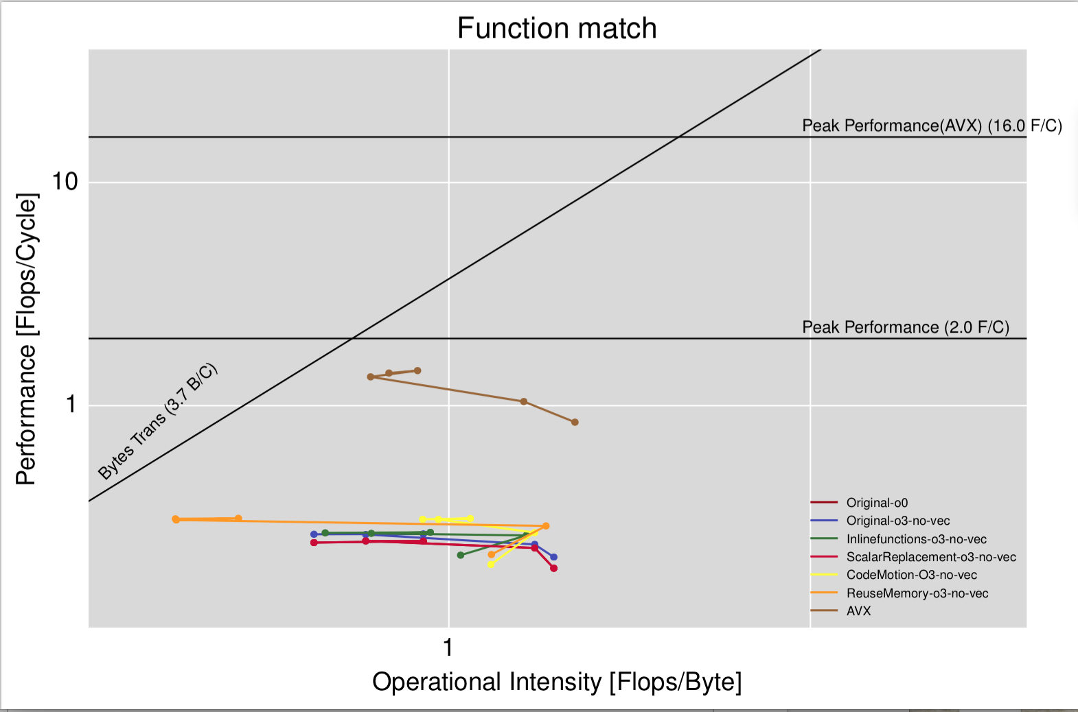
Roofline (compute_data_and_match)
Environment:
Sandy-Bridge
Notes:
compute bound: after reweight, the performance is close to peak performance.
We get the RAM peak performance from Geekbench
The peak performance without AVX is 2 flops/cycle, it is 16 flops/cycle with AVX. (sandy-bridge)
the intensity is affected by the input image size.

Slide 12
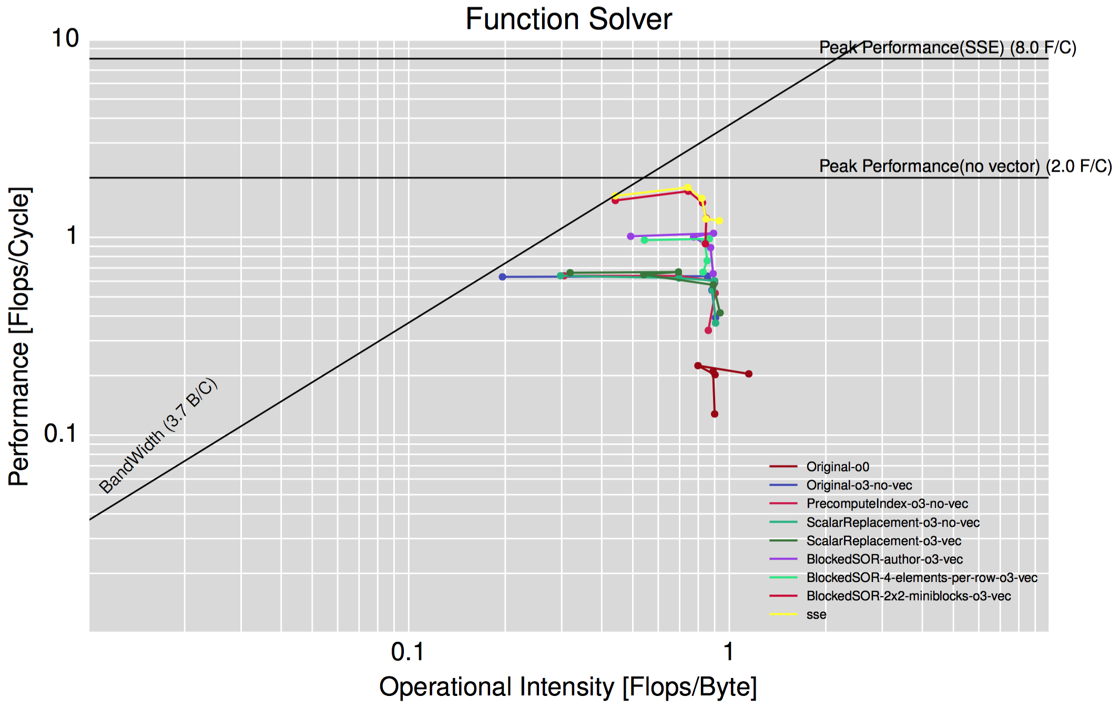
Roofline (solver)

Slide 13

Notes:
Algorithm characteristic: lots of interactions, use as much memory with the increase of size of image for computation use.

Slide 14
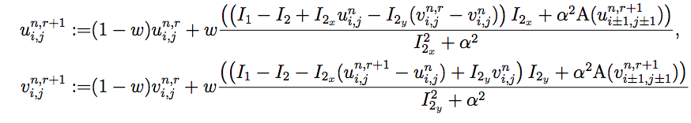
Theory Appendix
Non-convex and non-linear -> incremental coarse to fine warping strategy with down sampling.
Three loops
Outer loop: Move along the image pyramid.
Middle loop: outer layer fixed point iteration -> update flow increments and non-linear weight iteratively.
Inner loop: inner layer fixed point iteration -> Use successive over-relaxation method to approximate the solution.

Slide 15
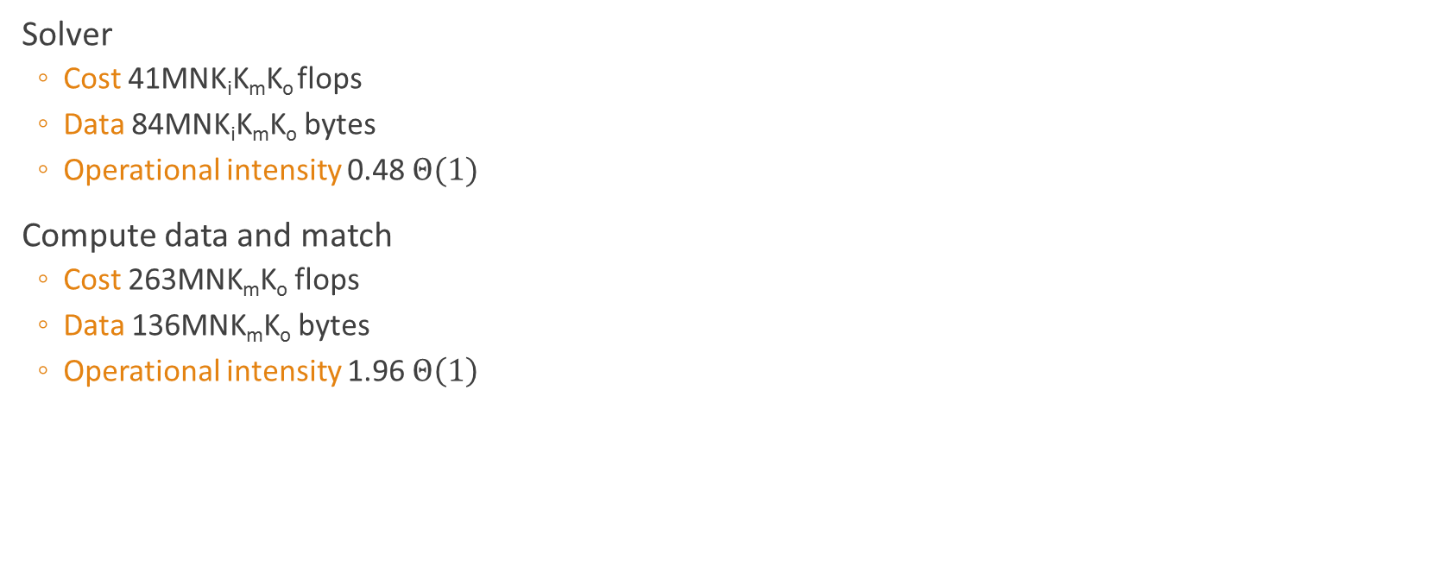
Performance Appendix
With M, N as the height and the width of the input image.

